Slide 1
MEDICAL FAQ BOT
BY TEAM BOURGUIBA

Slide 2
Problem Statement
The decreasing doctor-patient ratio in Nigeria is leading to overburdened healthcare providers, resulting in inadequate public access to accurate medical information.

Slide 3
Our Solution
A medical FAQ bot that provides the public with answers to frequently asked medical questions to relief overburdened health care providers and delayed patients.

Slide 4
Data Sources
Data sources we considered are:
Health Assistant dataset
Question and Answer dataset
Mental Health Conversational dataset
Mental Health Conversational dataset
Medical Question Answering
We reviewed samples from different data sources to confirm that they align with project’s requirement of medical related question and answer pairs

Slide 5
Modelling Approaches
Fine-tuning with pre-trained Language models:
GPT-2
XLNet
BERT
Retrieval-Augmented Generation:
Facebook RAG Token model
Open AI GPT 3.5 with Langchain
Llama2 with Langchain

Slide 6
SAMPLE RESULT
Question: What are some effective techniques for managing and reducing anxiety and stress levels?
Answer:
1. Seek out sources of self-help; they can be helpful in the prevention, diagnosis, treatment, or relief of anxiety, stress, depression, or other psychological disorders.
2. Exercise regularly and don’t smoke. Be as physically active as you are and practice relaxation techniques such as deep breathing and meditation.
3. If you’re stressed, don’t be afraid to seek help for help if you are stressed. This can help improve your mood and anxiety level and help you cope with your triggers.
4. If needed, use relaxation techniques like yoga, tai chi, or guided relaxation programs.
5. Get enough sleep and stay hydrated throughout the day

Slide 7
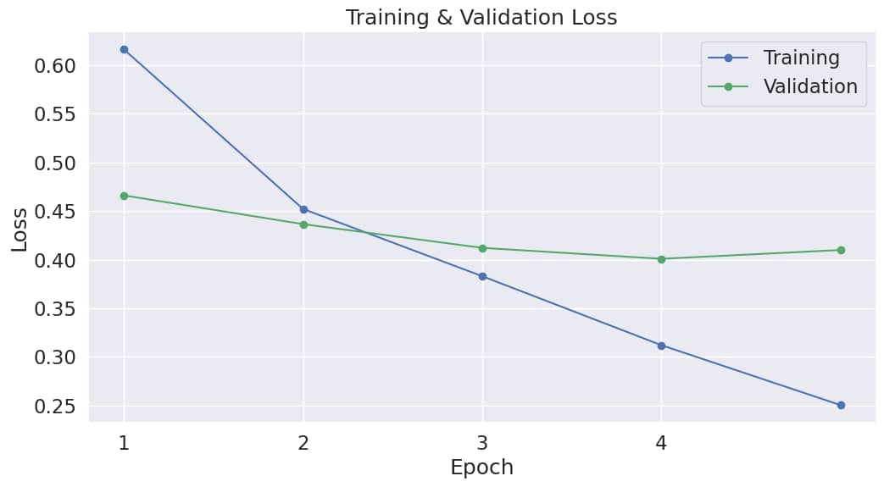
Result
We successfully fine-tuned GPT2 language model on datasets of over 17 thousand plus medical question and answer pairs by training it for 5 hours 30 minutes on a Tesla T4 GPU via colab.

Slide 8
Limitations
Insufficient data
Insufficient computational resources for training
High learning curves
Unavailable group members
Insufficient experimentation time

Slide 9
Conclusion
We successfully trained a model to answer frequently asked medical questions using PyTorch and Hugging Face. In the process, we learned to experiment with different models and methods for building question answering systems.
While we plan to create a demo using the model, we also believe that before a model like this can be released, its output would need to be reviewed by medical professionals. Also, with more resources, advanced models like GPT3.5 or GPT4 can be used for the same task.

Slide 10
Thank You!

